Slide 1

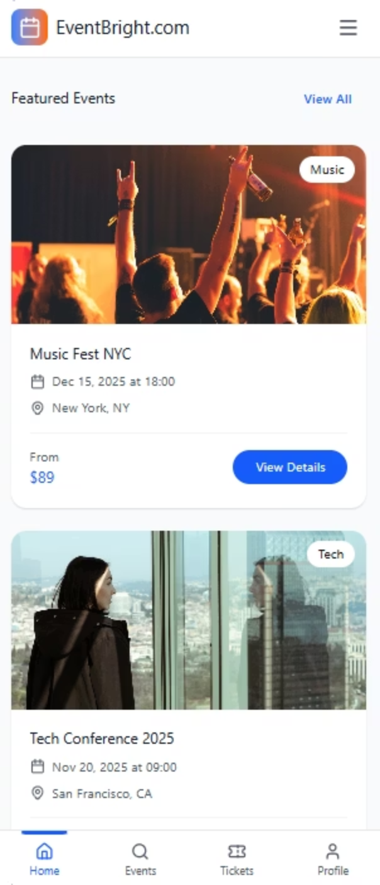
Online Event Ticket Booking Website
Project Name: EventBright
Project Type: Online Event Hosting & Ticket Booking Platform
EventBright is a web-based application that provides a centralized platform for discovering, hosting, and booking tickets for various types of events such as academic seminars, corporate conferences, concerts, exhibitions, and social gatherings. The platform is designed to simplify the event discovery and ticket purchasing process for users while providing event organizers an easy way to publish and manage their events online.

Slide 2
Why This Project?
In today’s digital era, people rely heavily on online platforms to discover activities and events. However, event-related information is often scattered across social media, websites, and physical advertisements. Many users face difficulties such as:
Searching multiple platforms to find events
Limited access to verified event details
Inconvenient physical ticket purchasing
Lack of student or group discount visibility
EventBright was created to solve these problems by offering one reliable platform where all events and ticketing services are available in one place.

Slide 3

Problem Statement (User Pain Points)
Problems Faced by Event Attendees:
Problems Faced by Event Organizers:
No single trusted platform for all event categories
Manual ticket buying wastes time
Lack of clear information about events
Difficulty in comparing prices and ticket types
Limited reach for event promotion
Manual handling of registrations and ticket sales
No easy way to manage attendees digitally
These challenges create inconvenience for both users and organizers.

Slide 4

How We Address User Pain Points
EventBright addresses these issues through the following solutions:
A centralized event listing system for all event types
Online ticket booking with instant confirmation
Multiple ticket types such as individual, student, group, and corporate
Search and filter options to find relevant events easily
Digital event hosting through simple online forms
This approach improves accessibility, reduces manual work, and enhances overall user experience.

Slide 5

Target Audience
Primary Target Users: Event Attendees
Event Organizers
Universities and educational institutions
Companies and corporate event planners
Community organizers and social groups
Students looking for seminars, workshops, or entertainment
Professionals attending conferences or networking events
General users interested in social or cultural activities
EventBright benefits users by saving time and providing easy access to event information and ticket booking.

Slide 6
Usability Evaluation
Usability was a key focus during the design of EventBright. We ensured:
Simple and intuitive navigation
Clean and minimal user interface
Clear buttons and readable content
Logical flow between pages (Home → Events → Booking)
Mobile-responsive design
Before development, a Figma-based prototype was created to test navigation flow and screen clarity, ensuring ease of use for first-time users.

Slide 7
Longevity & Future Extension Plan
EventBright is designed to be scalable and adaptable for future enhancements. Possible future extensions include:
Mobile applications for Android and iOS
Personalized event recommendations using user interests
Push notifications and email alerts for upcoming events
International payment gateway integration
Admin dashboard with analytics and reports
Multi-language support
These features can help the platform grow and remain relevant over time.

Slide 8
Technologies Used
Frontend Technologies:
Backend Technologies:
HTML for structure
CSS for styling
JavaScript for interactivity
React.js for building reusable UI components
Node.js for server-side development
Express.js for API handling
Database:
PostgreSQL for structured and secure data storage
Tools:
Figma for UI/UX prototyping
GitHub for version control
Postman for API testing

Slide 9
Pricing Model
EventBright follows a simple and realistic pricing strategy:
Transaction-based model:
Promoted events:
Free access for users to browse and search events.
Organizers can pay to feature their events
A small service fee per ticket sold

Slide 10

Team Roles
Team Responsibilities:
Project Manager (Syed Asad Hussain):
Frontend Developer (Muhammad Maaz & Muhammad Ayaan):
Requirement gathering and planning
Task allocation and progress tracking
Ensuring timely completion
Designing user interfaces using React
Implementing responsiveness and navigation
Connecting frontend with backend APIs
Backend Developer (Muhammad Salman & Ahtisham Ansari):
Backend Developer (Muhammad Salman & Muhammad Maaz)
Developing APIs using Node.js
Handling business logic and authentication
Designing PostgreSQL database
Managing data flow and API integration

